Slide 1


AE-203 FLUID MECHANICS AND HYDRAULIC MECHANICS INNOVATIVE PROJECT REPORT
“Heat Mass and Momentum transfer of Fluids in Diesel Engine”
SUBMITTED BY
SHAYAN KHAN (2K21/AE/56)
SUBMITTED TO: DR. R. S. MISHRA PROFESSOR

Slide 2
Motivation for Project
Motivation – Curiosity to understand working and basic principles of fluid flow in diesel engine, encouraging our own selves and others to explore and moreover enlighten people about the basics of diesel engine. Higher efficiencies reduce fuel consumption, emissions of air pollutants and greenhouse gases, and cooling water requirements. So, this inspired us to take up this project work and do research work on fluid flow Diesel engine and to know how they can be improved so as to increase their efficiency and reduce fuel consumption for a better future.
WHAT WE WANT TO DO
Through this project, we will analyze the fluid flow mechanism in diesel engine. We will see if there is an option for further improvement to this. We will also provide solutions to any gaps in research work that is undergoing.

Slide 3
Introduction
In this project we have studied about fluid flow mechanism in diesel engine and its basic fundamentals from various research papers published by scholars. Any internal combustion engine that uses diesel fuel that has been pumped into the cylinder and heated to a temperature high enough to ignite it is referred to as a diesel engine. It transforms the chemical energy contained in the fuel into mechanical energy that can be utilized to drive marine vessels, heavy tractors, freight trains, and locomotives. Several electric generators sets and a small number of cars are also diesel-powered. A diesel engine is an intermittent combustion piston cylinder device. It operates on either a 2-stroke or a 4-stoke cycle. However, unlike the spark engine gasoline engine, the diesel engine includes only air into the combustion chamber on its intake stroke. Compression ratio is in the range of 14:1 to 22:1.

Slide 4
The diesel engine, named after Rudolf Diesel, is an internal combustion engine in which ignition of the fuel is caused by the elevated temperature of the air in the cylinder due to mechanical compression; thus, the diesel engine is called a compression-ignition engine (CI engine). This contrasts with engines using spark plug-ignition of the air-fuel mixture, such as a petrol engine (gasoline engine) or a gas engine (using a gaseous fuel like natural gas or liquefied petroleum gas). Diesel engines work by compressing only air, or air plus residual combustion gases from the exhaust (known as exhaust gas recirculation, "EGR"). Air is inducted into the chamber during the intake stroke, and compressed during the compression stroke. This increases the air temperature inside the cylinder so that atomised diesel fuel injected into the combustion chamber ignites. With the fuel being injected into the air just before combustion, the dispersion of the fuel is uneven; this is called a heterogeneous air-fuel mixture.

Slide 5
The torque a diesel engine produces is controlled by manipulating the air-fuel ratio (λ); instead of throttling the intake air, the diesel engine relies on altering the amount of fuel that is injected, and the air-fuel ratio is usually high.
The diesel engine has the highest thermal efficiency (engine efficiency) of any practical internal or external combustion engine due to its very high expansion ratio and inherent lean burn which enables heat dissipation by the excess air. A small efficiency loss is also avoided compared with non-direct-injection gasoline engines since unburned fuel is not present during valve overlap and therefore no fuel goes directly from the intake/injection to the exhaust. Low-speed diesel engines (as used in ships and other applications where overall engine weight is relatively unimportant) can reach effective efficiencies of up to 55%.^{[1]} The combined cycle gas turbine (Brayton and Rankine cycle) is a combustion engine that is more efficient than a diesel engine, but it is, due to its mass and dimensions, unsuited for vehicles, watercraft, or aircraft. The world's largest diesel engines put in service are 14-cylinder, two-stroke marine diesel engines; they produce a peak power of almost 100 MW each.

Slide 6
Diesel engines may be designed with either two-stroke or four-stroke combustion cycles. They were originally used as a more efficient replacement for stationary steam engines. Since the 1910s, they have been used in submarines and ships. Use in locomotives, buses, trucks, heavy equipment, agricultural equipment and electricity generation plants followed later. In the 1930s, they slowly began to be used in a few automobiles. Since the 1970s energy crisis, demand for higher fuel efficiency has resulted in most major automakers, at some point, offering diesel-powered models, even in very small cars.^{[3][4]} According to Konrad Reif (2012), the EU average for diesel cars at the time accounted for half of newly registered cars. However, air pollution emissions are harder to control in diesel engines than in gasoline engines, so the use of diesel auto engines in the U.S. is now largely relegated to larger on-road and off-road vehicles.
Though aviation has traditionally avoided diesel engines, aircraft diesel engines have become increasingly available in the 21st century. Since the late 1990s, for various reasons – including the diesel's normal advantages over gasoline engines, but also for recent issues peculiar to aviation – development and production of diesel engines for aircraft has surged, with over 5,000 such engines delivered worldwide between 2002 and 2018, particularly for light airplanes and unmanned aerial vehicles.

Slide 7
In 1878, Rudolf Diesel, who was a student at the "Polytechnikum" in Munich, attended the lectures of Carl von Linde. Linde explained that steam engines are capable of converting just 6–10% of the heat energy into work, but that the Carnot cycle allows conversion of much more of the heat energy into work by means of isothermal change in condition. According to Diesel, this ignited the idea of creating a highly efficient engine that could work on the Carnot cycle. Diesel was also introduced to a fire piston, a traditional fire starter using rapid adiabatic compression principles which Linde had acquired from Southeast Asia. After several years of working on his ideas, Diesel published them in 1893 in the essay Theory and Construction of a Rational Heat Motor.
Diesel was heavily criticised for his essay, but only few found the mistake that he made his rational heat motor was supposed to utilise a constant temperature cycle (with isothermal compression) that would require a much higher level of compression than that needed for compression ignition. Diesel's idea was to compress the air so tightly that the temperature of the air would exceed that of combustion. However, such an engine could never perform any usable work. In his 1892 US patent (granted in 1895) #542846, Diesel describes the compression required for his cycle:

Slide 8
Pure atmospheric air is compressed, according to curve 1 2, to such a degree that, before ignition or combustion takes place, the highest pressure of the diagram and the highest temperature are obtained-that is to say, the temperature at which the subsequent combustion has to take place, not the burning or igniting point. To make this more clear, let it be assumed that the subsequent combustion shall take place at a temperature of 700°. Then in that case the initial pressure must be sixty-four atmospheres, or for 800° centigrade the pressure must be ninety atmospheres, and so on. Into the air thus compressed is then gradually introduced from the exterior finely divided fuel, which ignites on introduction, since the air is at a temperature far above the igniting-point of the fuel. The characteristic features of the cycle according to my present invention are therefore, increase of pressure and temperature up to the maximum, not by combustion, but prior to combustion by mechanical compression of air, and there upon the subsequent performance of work without increase of pressure and temperature by gradual combustion during a prescribed part of the stroke determined by the cut-oil.

Slide 9
Literature Review
R.D. Reitz & C.J. Rutland carried out the development and testing of diesel engine CFD models and found out that maximizing the efficient power function gives a compromise between power and efficiency. Out of the 3 alternate criterions that were used during analysis i.e. maximizing power is more suitable for design of practical diesel engines which are more efficient and emits CO2 AND toxic emissions. No exergy analysis was done.
Kochadze T. carried out the analysis and assessment of gas diesel cycle efficiency. The analysis shows that the design parameters such as volume ratio of the diesel engines at maximum energy density conditions leads to more efficient engines. The analysis shows that the design parameters such as volume ratio the diesel engines at maximum energy density conditions leads to more efficient engines. NOx and other emission analysis are missing.
Magin Lapuerta The effect of variable specific heats of operational fluid on the actual Cycle’s performance has a significant impact on engine performance and should be incorporated when evaluating practical cycle engines. The results could be an essential guide for the design of real Diesel engines by engine manufacturers. The peak output power and corresponding maximum efficiency, the power at the highest efficiency, and the efficiency at the highest power improve with increasing maximum cycle temperature. NOx and other emission analysis are missing.

Slide 10
M.Evna Alam Fahd carried out experimental investigation of the performance and emission characteristics of direct injection diesel engine by water emulsion diesel under varying engine load condition The use of the combustion correlation enables the effects of changing ambient conditions, turbocharger match, valve timing and other engine design parameters to be predicted automatically,
Bang-Quan He carried out the thermal analysis on effect of Ethanol blended diesel fuels on a diesel engine Based on the overall analysis, biodiesel blends BD20 is more effective than others and can be used in the diesel engine in controlling air pollution as well as the approach of acquiring energy in the long run.
R.D. Reitz & C.J. Rutland has carried out CFD modelling that shows that the details of intake flow process influence the engine performance. the CFD model is able to correctly predict the soot— NOx trade-off trend as a function of injection timing. No complexities of function of late injection were studied and mentioned.
N. Watson has carried out the thermal analysis in which the effect of biodiesel fuel or diesel engine is analyzed. There have been many results found concerning about emission from biodiesel. In most cases, a dominant trend has been established; however, competing trends have always been put forth in other places, major reason behind is different engine technologies testing. No alternatives were mentioned and no exergy.

Slide 11
Prof. Dr. Kochadze T. ED10(emulsion diesel engine) has the potential to be considered as a competitive renewable and greener fuel for diesel engine applications. No solution to ED10 Engine suffering from high CO at low load and low engine speed.
Roshan Raman* and Naveen Kumar With the aid of additive and ignition improver, CO, unburned ethanol and acetaldehyde emissions of the blends can be decreased moderately. The results indicate the potential of diesel reformation for clean combustion in diesel engines. No exergy analysis done and no proper differences in emission were mentioned.
Palash Chakma, HaengMuk Cho With Different type biodiesel in exhaust system directly affects the performance and the emission characteristics of the internal combustion engine. For improvement in the performance of an engine, it is necessary to control the temperature in automotive exhaust system.
Heng Wu,Yanlin Ge,lingen Chen, Huijun Feng carried out experiment By connecting the finite time thermodynamics and the finite speed thermodynamics, an irreversible reciprocating Diesel cycle model is established with considering the irreversibilities caused by finite piston speed, heat transfer, friction, and internal irreversible loss.
M. Soundar carried out this research and analyzed the uncoated cylinder with coated one using ANSYS and in experimental method using thermal image camera. The result depicted that the ceramic coated cylinder is more efficient than uncoated one. To convert the waste heat into useful work the cylinder liners and piston head is coated with ceramic coating.

Slide 12
Panya Yodovard, Joseph Khedari, Jongjit Hirunlabh assesses the potential of waste heat thermoelectric power generation for diesel cycle and gas turbine cogeneration in the manufacturing industrial sector in Thailand. The potential of waste heat thermoelectric power generators was analyzed using an annual cost method based on stack exhaust from a cogeneration system for different operation hours, system life spans, bank interest rates, system prices, maintenance costs, depreciation, internal rates of return, and electricity buy back rates sold to the grid line.
Adnan Parlak observed a Diesel cycle analysis taking combustion and heat transfer into account on performance has been performed. The effect of heat transfer is analysed in terms of design parameters such as compression ratio and cut-off ratio. The effects of heat transfer from the cylinder on exhaust temperature were also investigated for different heat transfer and combustion modes.
Helton Aparecido ET.AL A diesel-cycle engine generator was used, with 7.36 kW (10 cv) of power and 5.5 kVA/5.0 kW of nominal power, with monophasic output tension of 120/240 V. The used fuels were crambe biodiesel (B100) and diesel oil (B0). Nominal resistive loads applied ranged between 1.0 kW and 5.0 kW. In order to quantify the emission of gases.
Ynalin Ge applied finite-time thermodynamics and air standard assumption, the irreversible Diesel cycle model is established with friction loss, heat transfer loss and internal irreversibility loss considered. Calculating the entropy generation rate by loss items, the cycle ecological function performance is optimized. The performance characteristics of ecological function and entropy generation rate are derived, and the impacts of three losses on ecological function performance are examined by the numerical method.

Slide 13
Sviatoslav kryshtopa*, Liudmyla kryshtopa, Vasyl melnyk, Bohdan dolishnii, Igor prunko, Yaroslav demianchuk carried out the research in which possibility of spirit fusel oil being used as an addition to agile fuels were considered. Results of experimental research on diesel engines working on mixtures of diesel fuel and fusel oils are given. The fuel economy and ecological indexes of engines working on mixtures of diesel fuel and fusel oils were improved.
Mohd Hafizil Mat Yasin carried out this research with other members which focuses on determining the effect of EGR and palm biodiesel on fuel consumption (SFC), exhaust gas temperature (EGT) and exhaust emissions (NOx, CO, UHC, and CO2). Experimental works using a multi-cylinder diesel engine with EGR and simulated works using Diesel-RK were performed at a constant engine speed of 2500 rpm in full load condition.
Qinming Tan carried out this research with other members ,In this based on the chemical reaction mechanism of fuel combustion, NO in the diesel emissions is mainly generated from N2 inside the burning environment of engine cylinder. Taking the gas mixture, O2 and CO2, as the intake air, nitrogen-free intake is accessible, and through simulative calculations and experiments, researchers can make a study of the ignition and combustion performances of the engines.
Sergejus Lebedevas with other research members presents a study on the energy efficiency and emissions of a converted high revolution bore 79.5 mm/stroke 95 mm engine with a conventional fuel injection system for operation with dual fuel feed: diesel (D) and natural gas (NG).

Slide 14
• Chander Shekhar Sharma(Indian Institute of Technology Ropar) carried out the analysis of diesel engine in-cylinder flow and combustion. Beginning from CAD data of the engine geometry, the methodology involves use of a commercial code AVL FIRE for simulation of suction stroke, and an open-source code KIVA-3V for simulation of the closed-valve part of the diesel cycle.
• U. Spicher, A. Velji, N. H. Huynh and F. Kruse carried out this research in which combustion zone (flame) propagation and flow velocities are measured using optical measurement techniques in a single–cylinder direct injected diesel engine. Cycle–resolved analysis indicates that the flow history tends to vary significantly from cycle to cycle. By analyzing pressure traces, a number of single cycles from flow and flame measurements were selected. A correlation of these measurements provided qualitative insight into the combustion process and allowed determination of a quantitative estimate of the combustion rate.
• Aguk Zuhdi Muhammad Fathallah, Wolfgang Busse, Fadhil Rizki Clausthaldi carried out the analysis to know the flow in the jacket cooling system for marine diesel engine 93 KW and the couple simulation between 1D modeling and 3D modeling, the methodology used. The analysis process was performed by using 3 diffrent softwares. The methodology to analysis fluid flow is CFD (computational fluid dynamic) with steps were problem identification, literature study, design the jacket cooling system based on the cummin diesel engine 93 KW.
• K. Abay,* , U. Colak & L. Yüksek carried out the research to analyze Efficient usage of fossil fuels and reduction of CO2 emissions are very important priorities for the automotive industry. Without increasing contributions from diesel engines and newer diesel technologies, it would not be possible to successfully meet fuel consumption and CO2 emission reduction targets.

Slide 15
• Stephen U. S. Chol and Jeffrey A. Eastman carried out the research to analyze Low thermal conductivity is a primary limitation in the development of energy-efficient heat transfer fluids that are required in many industrial applications. In this paper we propose that an innovative new class of heat transfer fluids can be engineered by suspending metallic nanoparticles in conventional heat transfer fluids. The resulting "nanofluids" are expected to exhibit high thermal conductivities compared to those of currently used heat transfer fluids, and they represent the best hope for enhancement of heat transfer.
• Jianmin Xu carried out the research to analyze the flow characteristics of intake manifold are analyzed and the intake unevenness of intake manifold is calculated. According to the flow field contours, the reason of generating non-uniformity of intake system is analyzed. The results show that the inlet end arranged in the middle of the intake manifold can reduce the non-uniformity of intake system.
• Tarek M. Belal, El Sayed M. Marzouk, Mohsen M. Osman carried out the research to get a a detailed understanding of the flow and combustion processes is required to improve performance and reduce emissions without compromising fuel economy. The simulation carried out in the present work to model DI diesel engine with bowl in piston for better understanding of the in cylinder gas motion with details of the combustion process that are essential in evaluating the effects of ingesting synthetic atmosphere on engine performance.

Slide 16
• Vinay Atgur, Gowda Manavendra, Gururaj Pandurangarao Desai and Boggarapu Nageswara Rao carried out the research deals with combustion simulations on four-stroke single-cylinder direct injection compression ignition engine running at a constant speed of 1500 rpm, injection timing of 25° BTDC with diesel and 20% blend of Jatropha biodiesel. Standard finite volume method of computational fluid dynamics (CFD) is capable of simulating two-phase engine flows by solving three-dimensional Navier–Stokes equations with k-ε turbulence model. Combustion simulations have been carried out for half-cycle by considering the two strokes compression and expansion at zero load condition.
• Faisal Lodi , Priyanka Arora, Svetlana Stevanovic carried out a A comprehensive analysis of combustion behaviour during cold, intermediately cold, warm and hot start stages of a diesel engine are presented. Experiments were conducted at 1500 rpm and 2000 rpm, and the discretisation of engine warm up into stages was facilitated by designing a custom drive cycle. Advanced injection timing, observed during the cold start period, led to longer ignition delay, shorter combustion duration, higher peak pressure and a higher peak apparent heat release rate (AHRR).
• Spicher, U; Velji, A; Huynh, N H; Kruse, F carried out an experiment where combustion zone (flame) propagation and flow velocities are measured using optical measurement techniques in a single-cylinder direct injected diesel engine. Combustion and, hence, flame propagation is detected by optical fibers and flow velocities have been measured by a new single-color, 2 dimensional Laser Doppler Velocimeter (LDV). Flame propagation and flow velocities could not be measured simultaneously.

Slide 17
Research Gap
The various research shows that the 4 stroke diesel engine can be easily run on various fuels which are ethanol , rapeseed oil , hydrogen , biodiesel , kanjara diesel etc. also these fuel can be made in factories, these are available in plenty, are cheaper compared to fossil fuels .Alternative fuels are much cleaner compared to diesel. In majority of the research papers it shows that we have to make a change in the diesel engine whether it can be fuel injector in which we can change the speed and pressure or we have to change the design of the injector nozzle to compensate for these deficits. We should work on ways in which we can directly use a common diesel engine by changing the fuels or mixing it in a way that we do not need to change the injectors. Also there is a need to make changes in the exhaust pipe so that and there is no need to add extra stuff such as addblue to make the exhaust gasses cleaner.

Slide 18






Chapter 4- Energy And Exergy analysis
Energy and Exergy Analysis
The engine is in steady-state condition.
It is assumed that the system is an open system and reference state is defined as T0 = 293 K
The combustion air and exhaust gases are ideal gas mixtures.
Mass balance for the control volume in steady state condition can be written as:
Energy balance for the control volume in steady state conditions— kinetic and potential energy being neglected:
The engine generates brake power and some heat produced by combustion is transferred to the environment. Equation can be written as:
The brake power is denoted as:
Efuel can be calculated using the mass flow rate of the fuel .m fuel and lower heating value of the fuel Hu as expressed by:
The engine characteristics are essentially expressed by thermal efficiency h and brake specific fuel consumption bsfc.

Slide 19


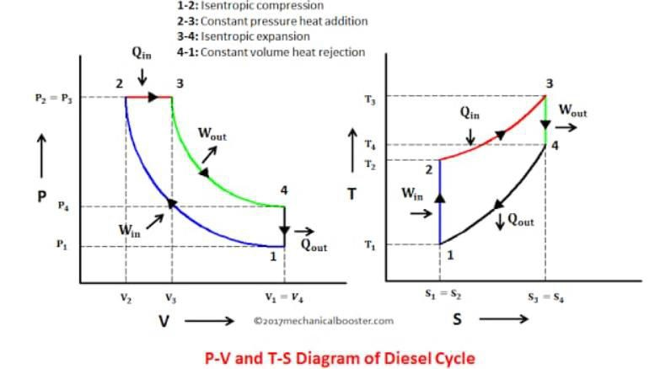
The assumptions made for energy analysis is also applicable for exergy analysis. Based on these assumptions, the exergy balance for the control volume can be given in the general sense by Equation:
The exergy transfer rate associated with work is equal to the net work for the engine:
The specific chemical exergy of fuel is computed by multiplying the lower heating value and chemical exergy factor as in the following equation:
The exergetic efficiency is a more accurate measurement of the system performance compared to the first law efficiency and it answers the question “how much of the fuel exergy is converted into power”. The exergetic efficiency, expressed as the ratio of brake power exergy to the fuel exergy of control the volume, can be calculated as follows:

Slide 20
Fluid mechanics and hydraulic mechanics
A performance analysis is performed on the air-standard Diesel cycle using finite-time thermodynamics. The relations between net work and/or power, efficiency, and compression ratio, and the maximum net work and/or power and the corresponding efficiency bound are derived for the cycle with heat-transfer considerations. Detailed numerical examples are given. The results obtained provide significant guidance to the performance evaluation and improvement for practice Diesel engines.
A performance analysis is performed on the air-standard Diesel cycle using finite-time thermodynamics. The relations between net work and/or power, efficiency, and compression ratio, and the maximum net work and/or power and the corresponding efficiency bound are derived for the cycle with heat-transfer considerations. Detailed numerical examples are given. The results obtained provide significant guidance to the performance evaluation and improvement for practice Diesel engines.

Slide 21
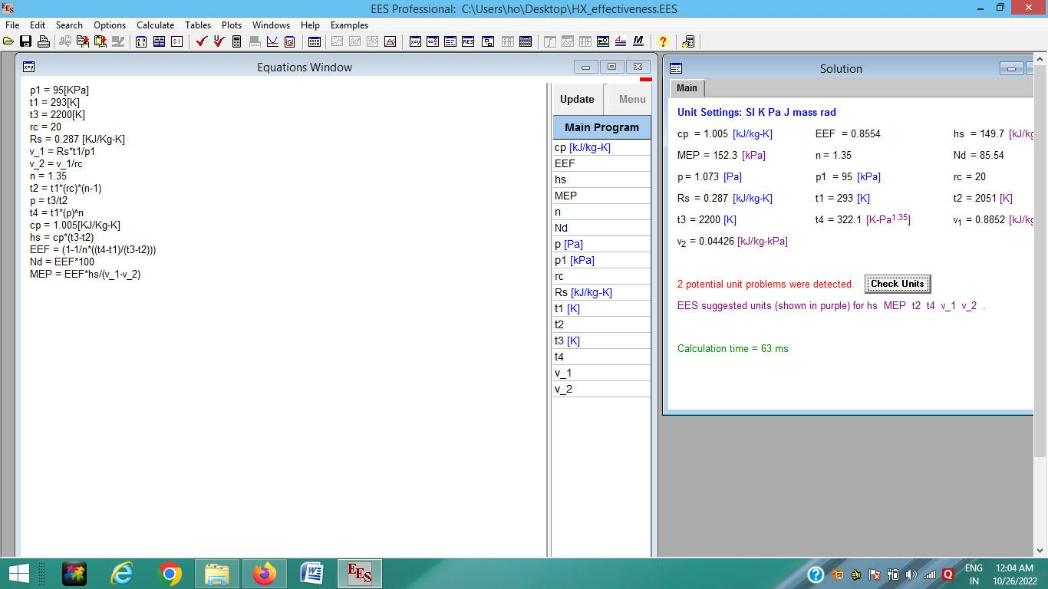
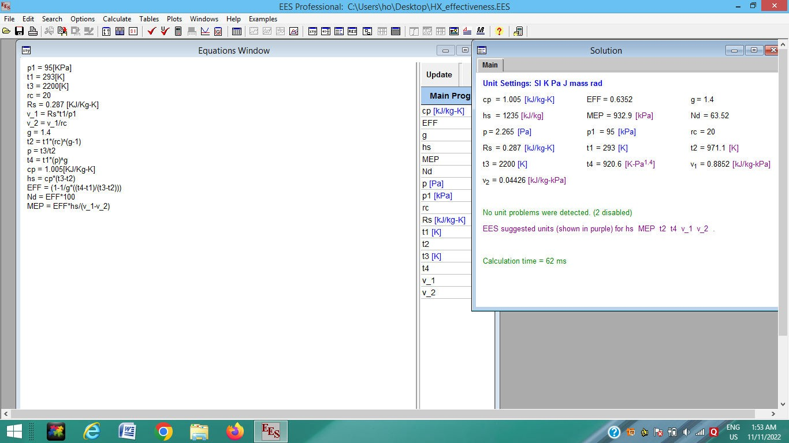
EES Code for Diesel Cycle

Slide 22
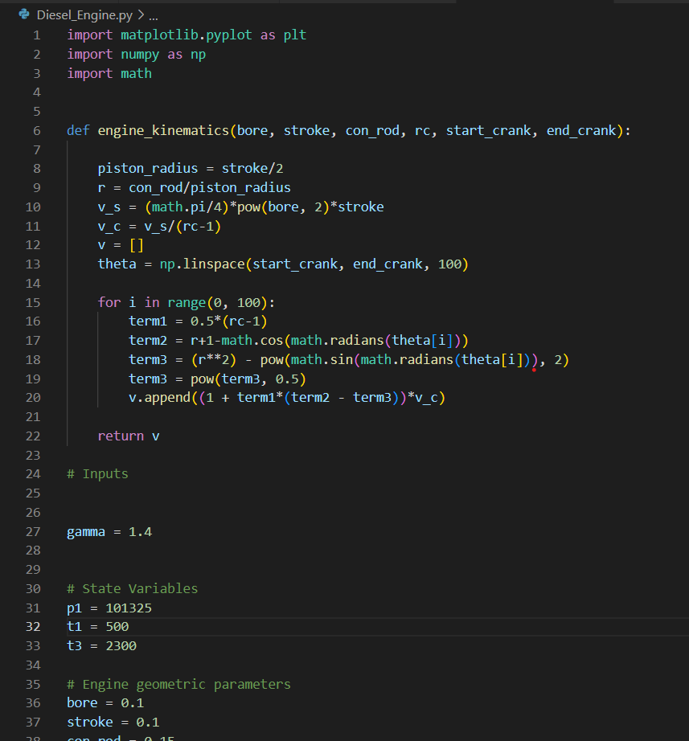
Thermal Code in Python

Slide 23
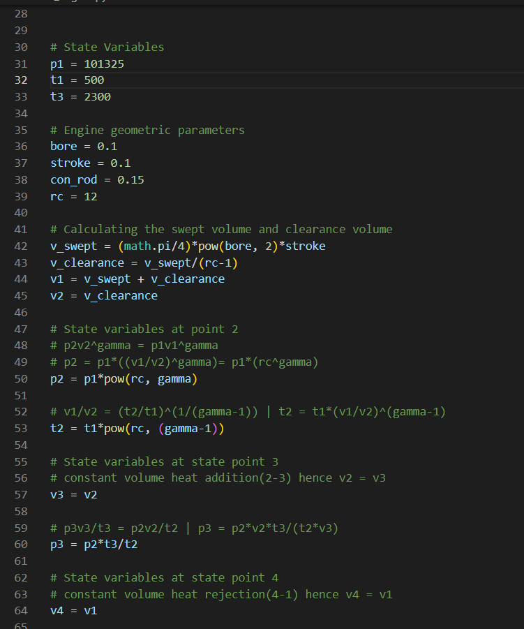
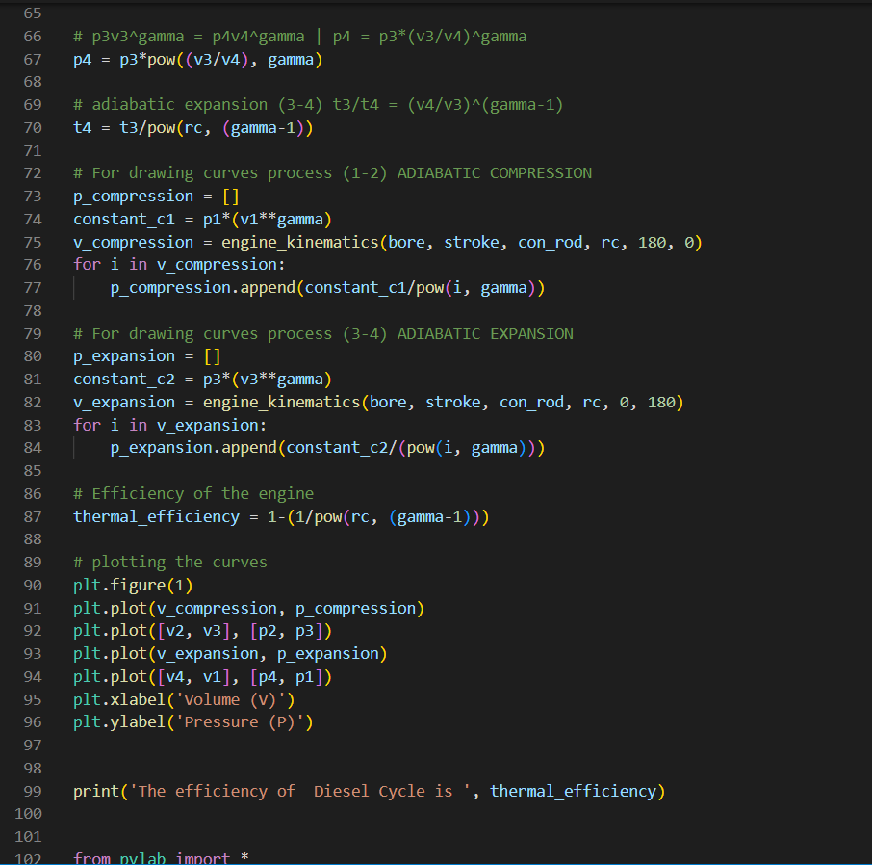

Slide 24
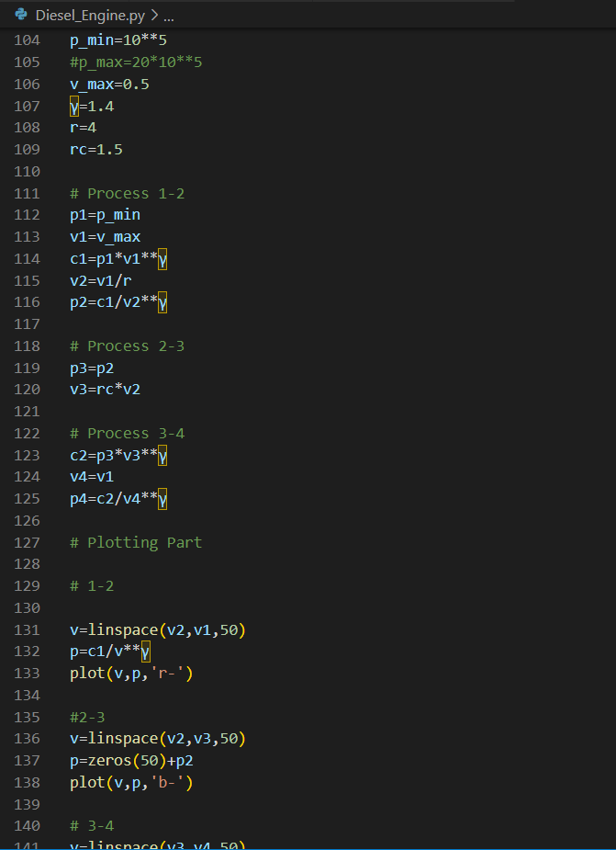
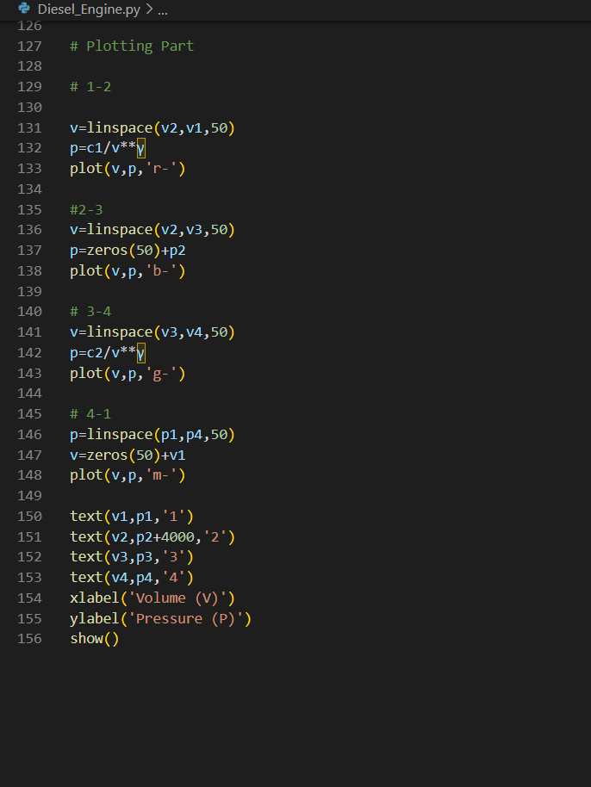

Slide 25


Slide 26
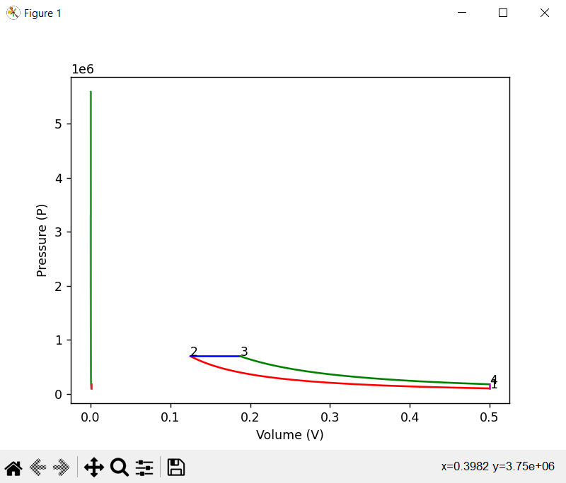
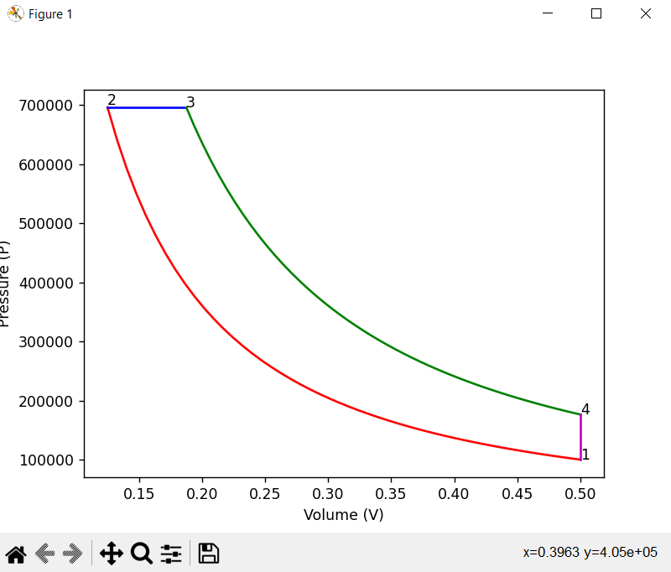
Result - Python Code

Slide 27
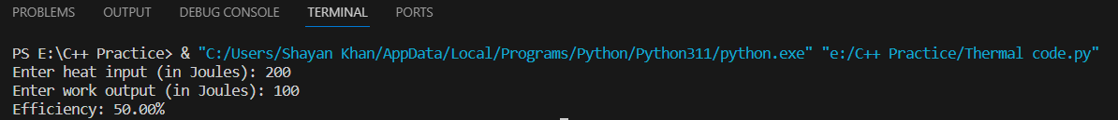
Result - Python Code

Slide 28
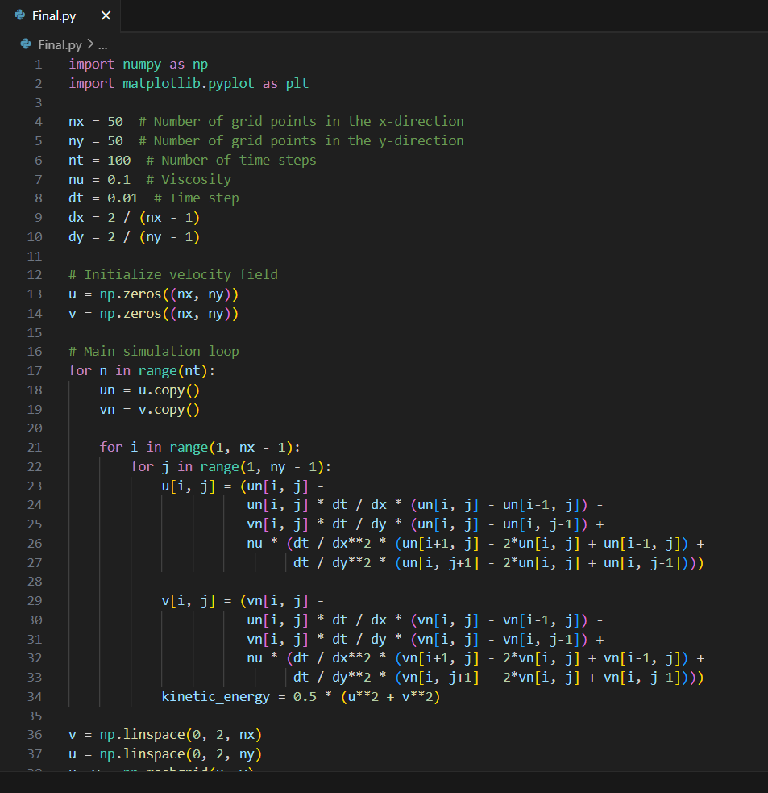
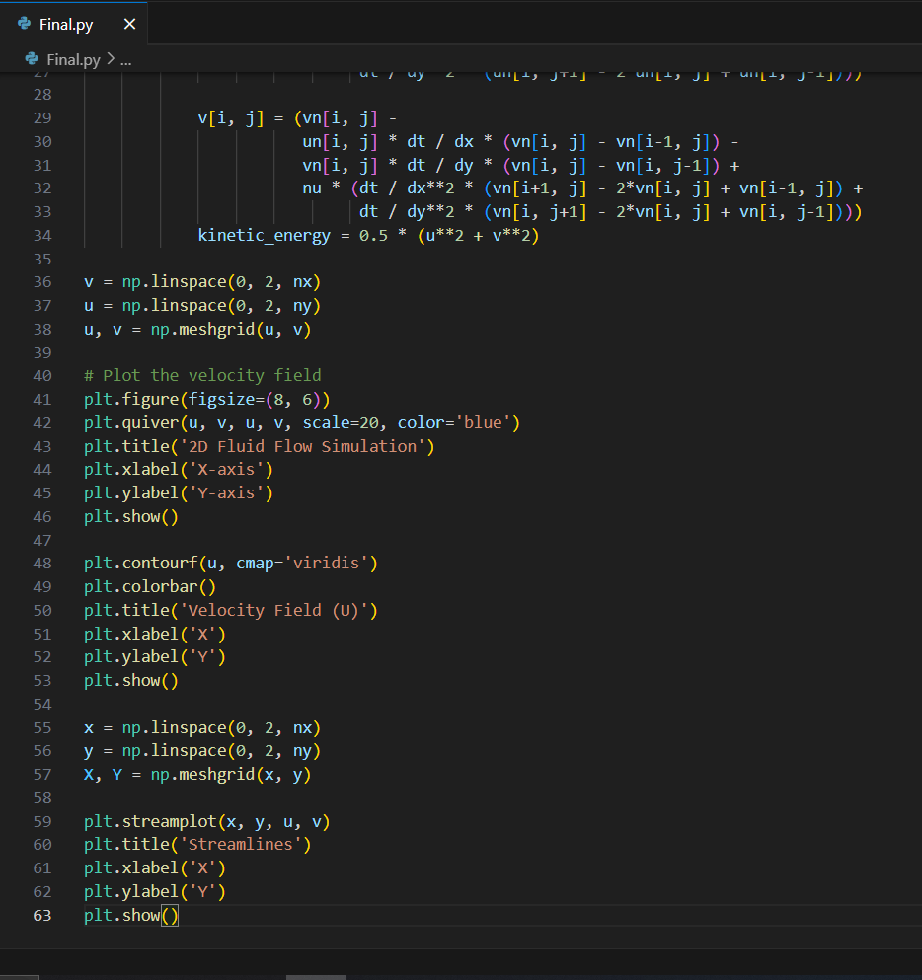
Fluid Simulation code in Python

Slide 29
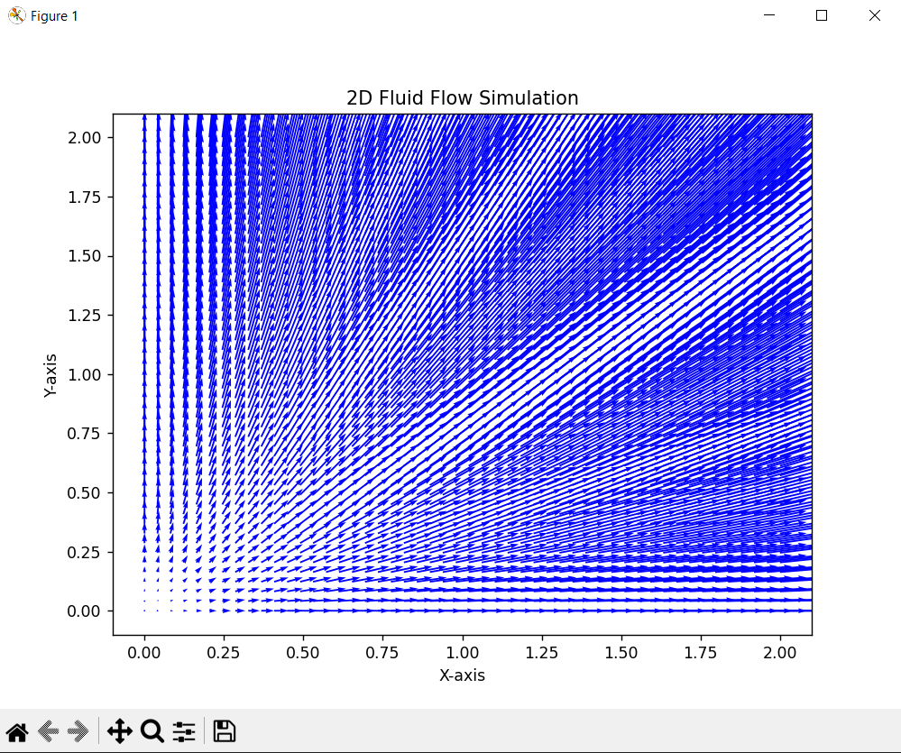
Result - Python Simulation Code (Fluid)

Slide 30
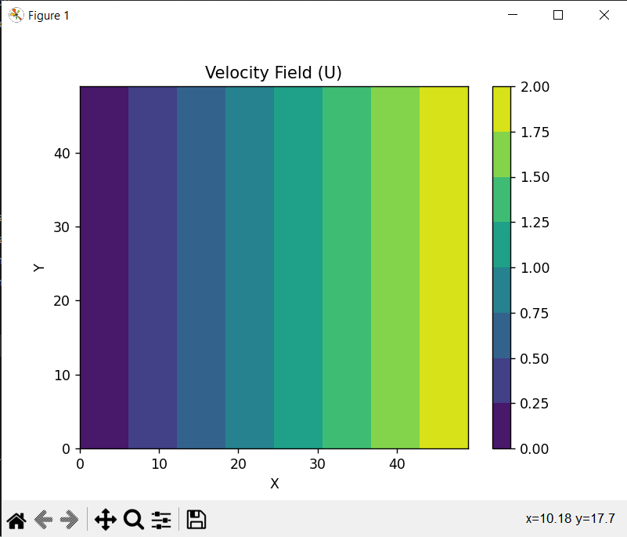
Result - Python Simulation Code (Fluid)

Slide 31
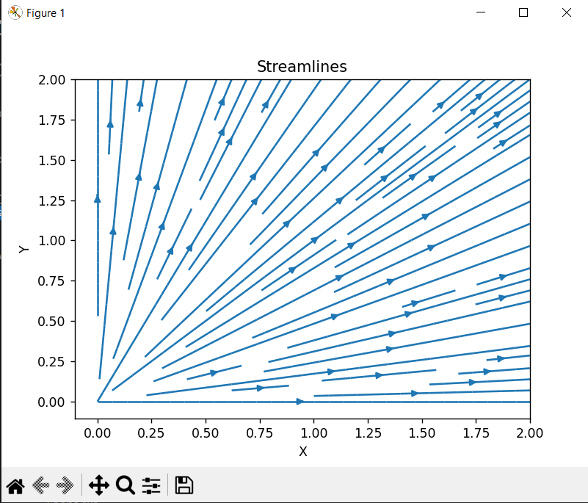
Result – Python Simulation Code (Fluid)

Slide 32
References
[1] R.D. Reitz & C.J. Rutland, 1995 “Development and testing of
Diesel Engine CFD models” International Journal Progress in Energy and Combustion Science, volume – 21 issue 2 page 173-196
[2] Magin Lapuerta ET. AL 2008 “Effect of biodiesel fuel or diesel engine” International Journal Progress in Energy and Combustion Science, volume 34 issue 2 page 198–223
[3] M.Evna Alam Fahd ET. AL 2013 “Experimental investigation of the performance and emission characteristics of direct injection diesel engine by water emulsion diesel under varying engine load condition” International Journal of Applied Energy, volume 102 page 1024-1049
[4] Bang-Quan He ET. AL 2003 “Effect of Ethanol blended diesel fuels on a diesel engine” International Journal Atmospheric Environment, volume 37 issue 35 page 4965-4971
[5] JaimeshKumar R Chaudhari and P.C. Sheth 2017 “Experimental investigation on diesel engine using smart biodiesel” International Journal of scientific and engineering reseach ISSN 2229 – 5518, volume 8 issue 3 page 268-274
[6] N. Watson ET. AL 1980 “Combustion Correlation for Diesel Engine Simulation” ISSN - 0148-7191 pages 13
[7] Mustafa Atmaca · Metin Gumus 2013 “Power and Efficiency Analysis of Diesel Cycle Under Alternative Criteria” DOI 10.1007/s13369-013-0773-0 ISSN - 2263–2270
[8] Prof. Dr. Kochadze T. ET.AL “ANALYSIS AND ASSESSMENT
OF GAS-DIESEL CYCLE EFFICIENCY” AkakiTsereteli state University- Kutaisi, Georgia ISSN 1310-3946
[9] Roshan Raman* and Naveen Kumar ” PERFORMANCE ANALYSIS OF DIESEL CYCLE UNDER EFFICIENT POWER DENSITY CONDITION WITH VARIABLE SPECIFIC HEAT OF WORKING FLUID” /doi.org/10.1515/

Slide 33
[10] Palash Chakma, HaengMuk Cho “A STUDY ON DIESEL ENGINE CHARECTERIZATION USING ALTERNATIVE FUEL AND
ITS BLENDS” International Journal of Applied Engineering Research ISSN 0973-4562 Volume 12, Number 16 (2017) pp. 5910-5915
[11] Heng Wu ET.AL “Power, efficiency, ecological function and ecological coefficient of performance optimizations of irreversible Diesel cycle based on finite piston speed” Institute of Thermal Science and Power Engineering, Wuhan Institute of Technology, Wuhan, 430205, PR China National Natural Science Foundation of China (Project Nos. 51779262 and 51576207)
[12] Panya Yodovard ET.AL “The Potential of Waste Heat Thermoelectric Power Generation From Diesel Cycle and Gas Turbine Cogeneration Plants” Issue 3 Volume 23
[13] Adnan Parlak “The effect of heat transfer on performance of the Diesel cycle and exergy of the exhaust gas stream in a LHR Diesel engine at the optimum injection timing”Volume 46, Issue 2, January 2005 101016
[14] Helton Aparceido “Biodiesel produced from crambe oil in Brazil—A study of performance and emissions in a diesel cycle engine generator” UNIOESTE – Western Paraná State University – Post-graduation Program, Master Course of Energy in Agriculture, Rua Universitária, 2069, CEP: 85.819-130
[15] Yanlin Ge ET.AL “Ecological optimization of an irreversible Diesel cycle”136, Article number: 198 (2021) [16] “Sviatoslav Kryshtopa ET.AL.” EXPERIMENTAL RESEARCH ON DIESEL ENGINE WORKING ON A MIXTURE OF DIESEL FUEL AND FUSEL OILS” Ivano-Frankovsk National Technical University of Oil and Gas 15, Carpathians street, Ivano-Frankovsk, 76019, Ukraine DOI:10.20858/tp.2017.12.2.6

Slide 34
[17] Mohd Hafizil Mat Yasin ET. AL. “STUDY OF A DIESEL ENGINE PERFORMANCE WITH EXHAUST GAS RECIRCULATION (EGR) SYSTEM FUELLED WITH PALM BIODIESEL” a Faculty of Mechanical Engineering, University Malaysia Pahang, Malaysia a Department of Mechanical and Mechatronic Engineering, University of Southern Queensland, Australia DOI: 10.1016/j.egypro.2017.03.100 [18] Qinming Tan ET .AL.“A STUDY ON THE COMBUSTION PERFORMANCE OF DIESEL ENGINES WITH O2 AND CO2 SUCTION” Merchant Marine College, Shanghai Maritime University, Shanghai 201306, China Volume 2016, Article ID 1258314, DOI:10.1155/2016 [19] Sergejus Lebedevas ET AL. “ RESEARCH ON FUEL EFFICIENCY AND EMISSIONS OF CONVERTED DIESEL ENGINE WITH CONVENTIONAL FUEL INJECTION SYSTEM FOR OPERATION ON NATURAL GAS” DOI:10.3390/en12122413 [20] M. Soundar ET AL. “IMPROVING THERMAL EFFICIENCY OF DIESEL ENGINE BY USING CERAMIC COATING ON CYLINDER LINER AND PISTON HEAD” Assistant Professor, Mechanical Engineering, SRM University Ramapuram campus, Chennai, India, ISSN Print: 0976-6340 and ISSN Online: 0976-6359

Slide 35
[21] Chander Shekhar Sharma ET.AL May 2010 “A methodology for analysis of diesel engine in-cylinder flow and combustion” - Progress in Computational Fluid Dynamics An International Journal 10(3) DOI:10.1504/PCFD.2010.033327
[22] U. Spicher, A. Velji ET.AL June 2014 “An Experimental Study of Combustion and Fluid Flow in Diesel Engines” SAE Transactions Vol. 96, Section 7: FUELS AND LUBRICANTS (1987), Published By: SAE International
[23] Aguk Zuhdi Muhammad Fathallah ET.AL Mar. 2017. “Fluid Flow Analysis of Jacket Cooling System for Marine Diesel Engine 93 KW”39-45 (ISSN: 2541-5972, eISSN: 2548-1479)
[24] Stephen U. S. Chol ET.AL July 2004. “Enhancing thermal conductivity of fluids with nanoparticles” Energy Technology Division and Materials Science Division ,Argonne National Laboratory Argonne, Illinois.
[25] K. Abay, ET,AL , February, 2018 “Computational fluid dynamics analysis of flow and combustion of a diesel engine” Journal of Thermal Engineering, Vol. 4, No. 2, Special Issue 7, pp. 1878-1895, Yildiz Technical University Press, Istanbul, Turkey
[26] Jianmin Xu An Experimental Study of Combustion and Fluid Flow in Diesel Engines” SAE Transactions Vol. 96, Section 7: FUELS AND LUBRICANTS (1987), Published By: SAE International
[27] Tarek M. Belal, Et.AL ,2013. “Investigating Diesel Engine Performance and Emissions Using CFD” Vol.5 No.2(2013), Article ID:29438,10 pages DOI:10.4236/epe.2013.52017
[28] Vinay Atgur, Gowda Manavendra, ET.AL 28 January 2022 ,” CFD Combustion Simulations and Experiments on the Blended Biodiesel Two-Phase Engine Flows” DOI: 10.5772/intechopen.102088
[29] Faisal Lodi , ET.AL 1 August 2020 , “Combustion Analysis of a Diesel Engine during Warm up at Different Coolant and Lubricating Oil Temperatures” Energies 2020, 13(15), 3931; https://doi.org/10.3390/en13153931
[30] Spicher, U ET.AL , U. Spicher, A. Velji ET.AL June 2014 “An Experimental Study of Combustion and Fluid Flow in Diesel Engines” SAE Transactions Vol. 96, Section 7: FUELS AND LUBRICANTS (1987), Published By: SAE International

